Slide 1

“This presentation is for informational purposes only and may not be incorporated into a contract or agreement.”

Slide 2
Enterprise Data Management
for RDF, OWL & Spatial Data
Xavier Lopez
Director, Server Technologies
Oracle USA, Inc.
“This presentation is for informational purposes only and may not be incorporated into a contract or agreement.”

Slide 3
Overview
Customer Requirements
Enterprise Geo-Semantic Architecture
Addressing Data Management Challenges
  RDF Data Models
  GeoSpatial Features (vector & raster)
Q & A

Slide 4
Our Customers Requirements:
Provide an open, secure, high performance graph data model and analysis platform
Perform SQL-based graph analysis using standards-based query (eg. SPARQL)
RDF Data Model with RDFS inferencing and support for user-defined rules;
OWL would be nice too
Enable combined SQL query of enterprise database, RDF graphs, Spatial data using single SQL statements
Support large graphs (millions & billion of triples)
Easily extensible by 3rd party tools/apps

Slide 5
What we were trying to avoid
Specialty RDF Data Stores
  Data isolation
  High systems admin
  and management costs
  Scalability problems
  High training costs
  Complex support problems
RDF/OWL data tightly coupled to specific application
Information not aligned with overall business processes
RDF/OWL
Triples
Business
Data
RDF Data
Server
Enterprise Data
Server
Semantic
Apps
Business
Apps

Slide 6
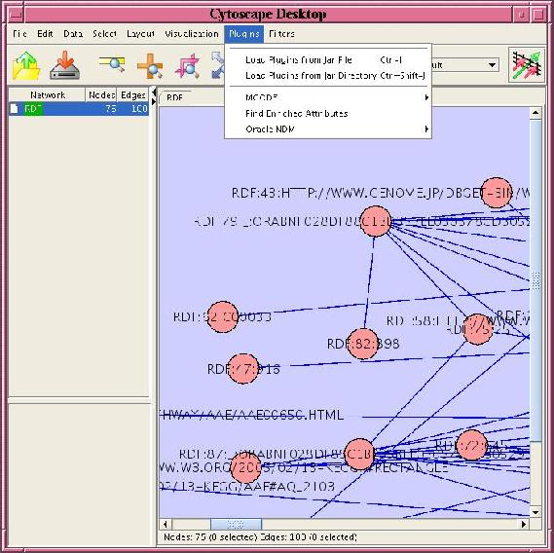
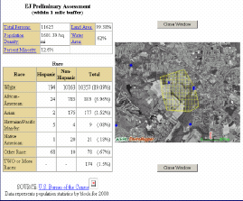
Geospatial Semantic Search
Semantic Tools
Ontology Engineering
Text Extraction
Geospatial Analysis
Graph Visualization
Semantic Search
Java, SQL API
Schemas:
Persistent RDF/OWL data
Persistent spatial data
Persistent raster data
Text, RDF data
Oracle Spatial 10g R2
RDF Models
Spatial Data

Slide 7
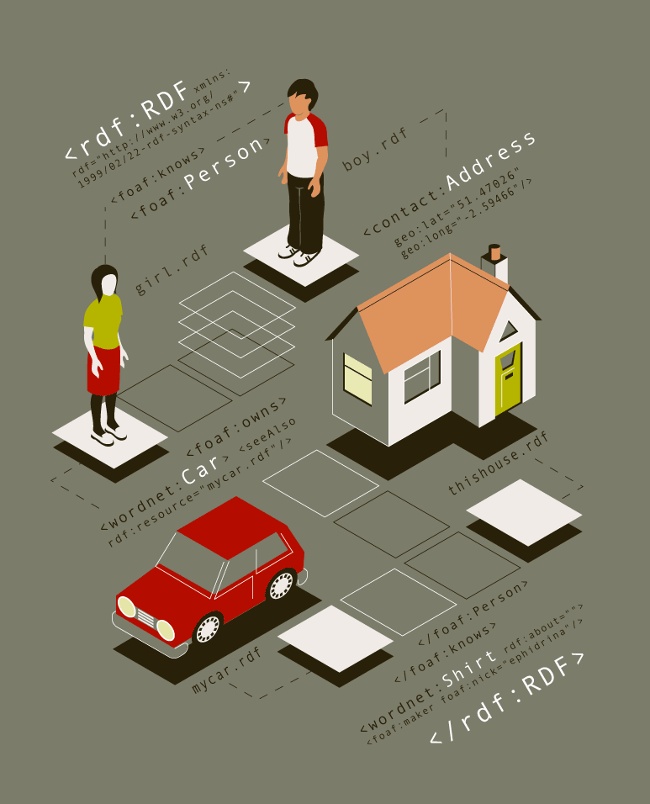
FOAF Example (X millions)

Slide 8



Application Integration
Domain
Ontologies
User
Query & results
Data
Ontologies
(Reasoning/Inferencing) Engine
Data Sources

Slide 9
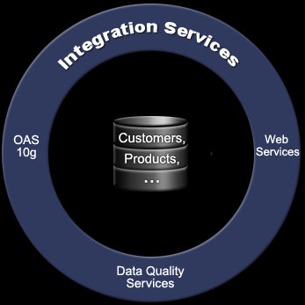


Oracle10g Value Proposition
Secure Geospatial Semantic Data Management
SOA Mediation Services
Scalable, high performance triple store for semantic and business information
Unparalleled security model and certifications
Integrated semantic and business queries
Leverage proven of RDBMS capabilities
Ontology Engineering
ETL
Ontology Search
Concept Mapping
Inferencing
Engines
Notes:
Oracle is specifically providing a Customer Data Hub that provides all the advantages of a data hub for ‘Customer” data.

Slide 10
Semantic Enterprise Platforms
Web Enabled Semantic Solutions
Enterprise Web Services
Software Platform
Integrated Business
Applications
Object-
Relational
Database
Application
Server
Mapping &
Semantic
Tools
Semantic Web
Services
Mashup APIs
Wikis
RDF/OWL Models
Vector Map Data
Raster Imagery
Image
XML
Text
Row Level Security
Web Services
Connection Pooling
Policy based management
Orchestration & Workflow
Security provisioning
Portal
Business Logic
Industry Models
Visualization
Rules Engines
Inferencing Engines
Policy Management
Semantic Mediation
Semantic Search
FOAF
Enterprise Information
Integration

Slide 11
RDF Support in
Oracle Database 10g R2

Slide 12
Oracle Introduces RDF Support
RDF Data Model
Model → RDF graph consisting of a set of triples
Rulebase → RDFS and user-defined rules
Rules Index → Inferred triples (on applying a rulebase to a model)
RDF Query
SDO_RDF_MATCH Table Function for SQL level access to RDF data
SQL based approach (instead of a new language approach)
Graph specification syntax based on SPARQL
Benefits:
  Leverage powerful SQL constructs to process RDF match results
  Combine SQL queries without staging

Slide 13
RDFS Native Inferencing Support
Employing symmetry and transitivity characteristics of properties to infer new relationships
RDF Statements + RDFS rules
Syntax for specifying user-defined rules
  Enabled by RDFS
Example of User defined rules:
  If John is parentOf Suzie
  And Suzie is parentOf Cathy
  Then John is grandParentOf Cathy

Slide 14
Performance Metrics
UniProt – 10M, 20M, 40M, 80M triples
Batch Loading
  1 million triples loaded in 35 minutes
Querying
  80M triples
  RDF_MATCH based query performance is scalable; retrieval performance almost same as dataset size grows
6 example queries given with UniProt
Number of matches remain constant as dataset size changes (ROWNUM)
See 2005 VLDP Paper:
www.oracle.com/technology/tech/semantic_technologies

Slide 15
UniProt Sample Queries
Description
Query Pattern
Projection
Result limit
Q1: Display the ranges of transmembrane regions
6 triples
5 vars
3 vars
15000 rows
Q2: List proteins with publications by authors with matching names
5 triples
5 vars
1 LIKE pred.
3 vars
10 rows
Q3: Count the number of times a publication by a specific author is cited
3 triples
2 vars
0 vars
32 rows
Q4: List resources that are related to proteins annotated with a specific keyword
3 triples
2 vars
1 var
3000 rows
Q5: List genes associated with human diseases
7 triples
5 vars
3 vars
750 rows
Q6: List recently modified entries
2 triples
2 vars
1 range pred.
2 vars
8000 rows

Slide 16
Query Response Times
RDF_MATCH Performance Scalability
Q1
Q2
Q3
Q4
Q5
Q6
10 M Triples
0.86
< 0.01
< 0.01
0.03
0.18
0.46
20 M Triples
0.95
< 0.01
< 0.01
0.03
0.19
0.47
40 M Triples
0.96
< 0.01
< 0.01
0.03
0.18
0.47
80 M Triples
1.03
< 0.01
< 0.01
0.03
0.20
0.49
Maximum σ
.054
0.002
0.002
.011
.065
0.07

Slide 17
Scalability
RDF & Spatial are Grid-enabled
32 and 64 bit processing
Database clustering
Multiple concurrent read/write sessions
Multiple OS and Hardware Platform Support
  Solaris, Linux, Unix, Windows
Back-up & recovery, fail over

Slide 18
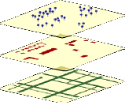


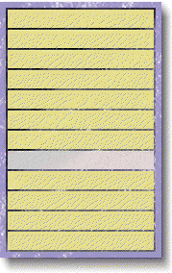




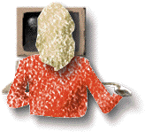
Securing Spatial & RDF Data
Points of Interest
Buildings
Infrastructure
Boundaries
Data Security
User Security
Network Security
Boundary a

Infrastructure


Boundary b
Point a
□

Building a

Building b
Infra B


Point b

Boundary c

Building C

Build D
Infra C


Infrastructure D

Point c

Privacy &
integrity of
communications
Access
control
Privacy &
integrity of
data
Comprehensive
auditing
Authenticate

Slide 19
What’s Coming?
Future direction for semantic data management
Increased load and query performance
OWL semantics, query & reasoning

Slide 20
Oracle Spatial Overview

Slide 21
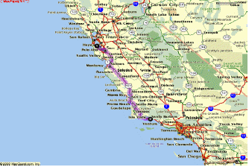
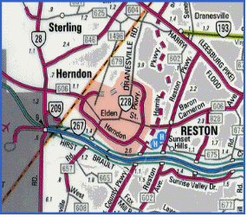
What is a Spatial Database?
Spatial Analysis
Spatial Data Types
  Spatial Indexing
Spatial
DBMS
Fast Access to
Spatial Data
All Location/Spatial Data
Stored in the Database
Spatial Access Through SQL
Notes:
61
15

Slide 22
All Spatial Types in Oracle 10g
Networks
(lines)
Locations
(points)
Parcels
(polygons)
Spatial
DBMS
Data
Rasters
(imagery, grids)
RDF/OWL
Semantic Models
Topological Relations
(persistent topology)

Slide 23
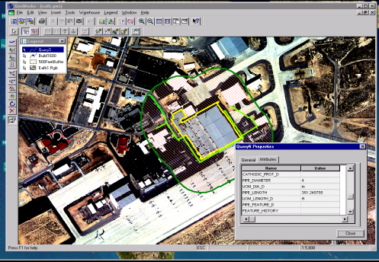
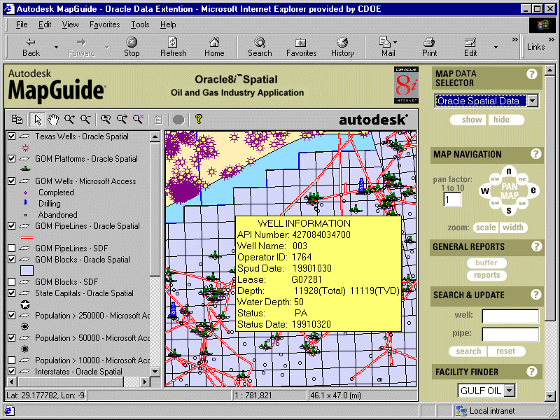
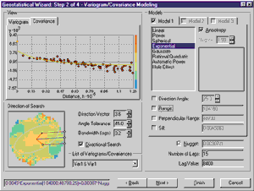
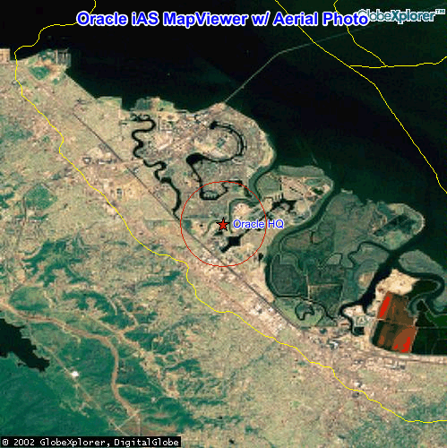
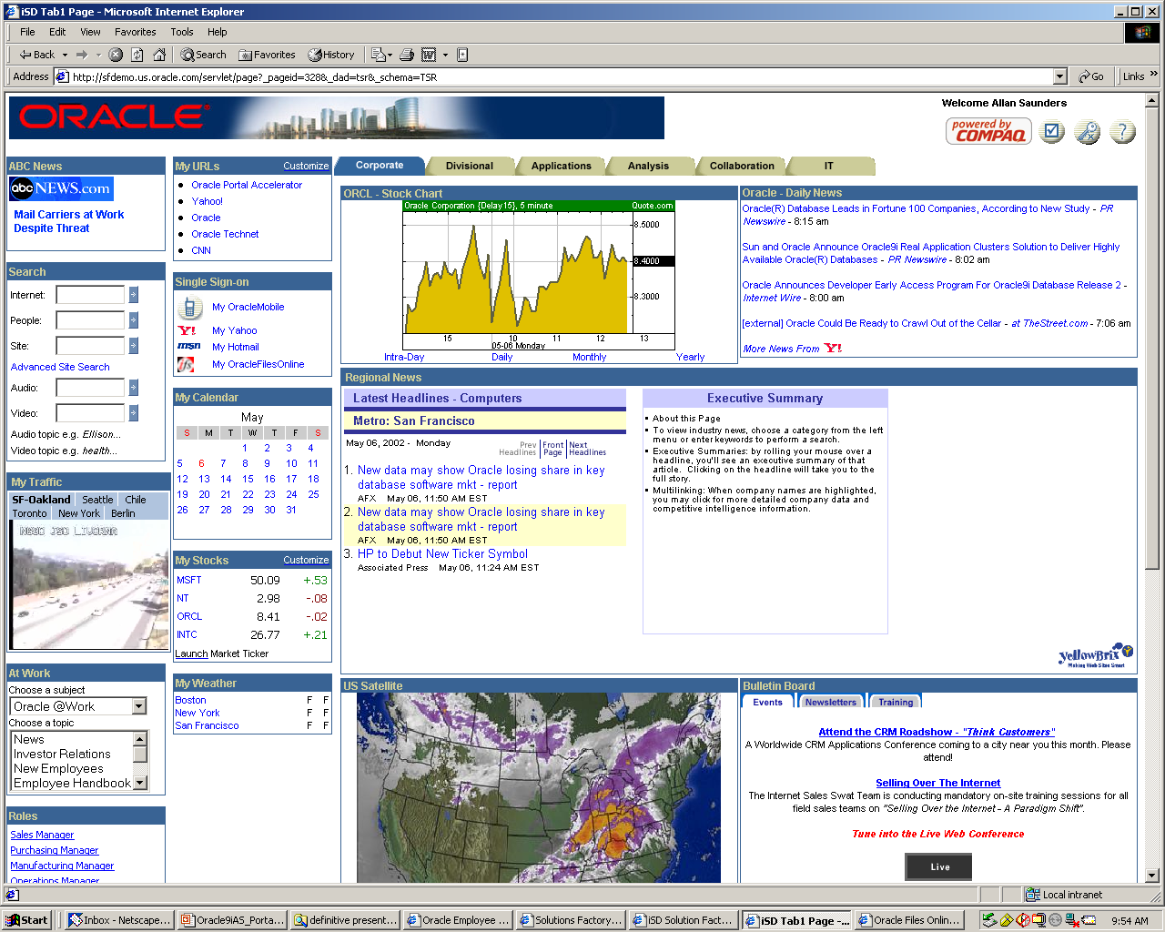
Driving Specialist & Generalist Apps
Asset Management
Environmental Planning
Business Intel
Emergency Mgmt
E-Government Portal
Notes:
Fusing Location with Business Information
Records
Images
Satellite imagery
2D & 3D Vector data
Sensor data feeds
Documents
Video
XML

Slide 24
Spatial Operators
Full range of spatial operators
  Implemented as functional extensions in SQL
  Topological Operators
    Inside Contains
    Touch Disjoint
    Covers Covered By
    Equal Overlap Boundary
  Distance Operators
    Within Distance
    Nearest Neighbor
INSIDE
X Distance
Hospital #2
First Street
Hospital #1
Main Street

Slide 25
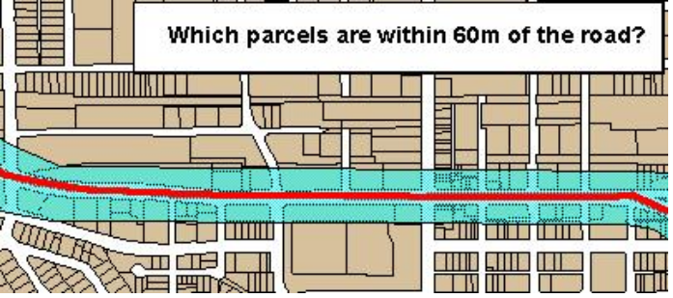
Spatial Functions
Return a geometry
  Union
  Difference
  Intersect
  XOR
  Buffer
  CenterPoint
  ConvexHull
Return a number
  Length
  Area
  Distance
Original
Union
Difference
Intersect
XOR

Slide 26
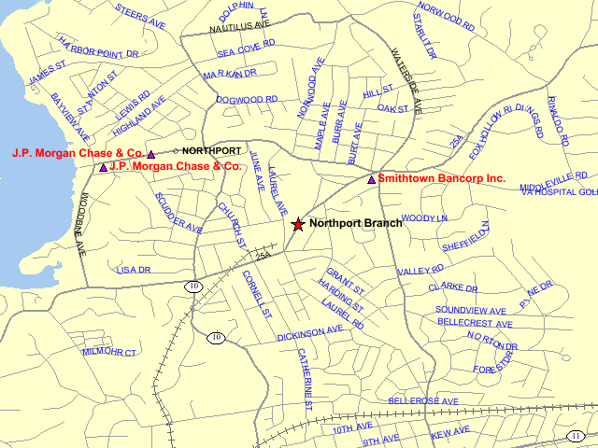
Proximity analysis
Find all competitors within 2 miles of Northport Branch
SELECT c.holding_company, c.location
FROM competitor c,
bank b
WHERE b.site_id = 1604
AND SDO_WITHIN_DISTANCE(c.location,
b.location,
'distance=2 unit=mile') = 'TRUE'

Slide 27
Oracle: Redefining a Spatial DBMS
SQL Spatial Type
R-Tree Index
Spatial Operators
Spatial Reference System
Coordinate System Support Based on EPSG Model
Geodetic (lat/long) Support
Linear Referencing
Spatial Aggregates
Versioning/Long Transactions
GeoRaster Type
Network Data Model
Topology Data Model
Geocoding Engine
Routing Engine
Spatial Data Analysis / Mining
GML 2.0 and 3.0
Oriented Point / Text Geometry
3D types & Functions (future release)
Web Feature Server (future release)
Web Catalog Server (future release)

Slide 28
Semantic Technology Opportunities
Unique Business Opportunities
  Life Sciences: pathway analysis, protein interaction
  Web: service discovery, FOAFs, blogs
  eBusiness: grid resources, app integration, Business Intel
  Intelligence: social networks, asset tracking
Applying Oracle10g to the Challenge
  Scalability: models comprising millions of graphs
  Security: Web-based, trust, reification
  Transaction, versioning, performance
  Interoperability: Integrating multiple graphs
  Exploit expressive power of SQL

Slide 29
More Information
www.oracle.com/technology/tech/semantic_technologies
Product Mgmt: Xavier.Lopez@oracle.com

